Slide 1
Model-Agnostic Meta-Learning for Fast Adaptation of Deep Networks and Meta-learning with latent embedding optimization
Chen Dalei
2019.11.19

Slide 2
Content
Chelsea Finn, Pieter Abbeel, and Sergey Levine, “Model-Agnostic Meta-Learning for Fast Adaptation of Deep Networks”, ICML, 2017
Andrei A. Rusu, Dushyant Rao, Jakub Sygnowski,” Meta-learning with latent embedding optimization”,ICLR,2019

Slide 3
1.MAML
MAML is a meta-learning algorithm that is general and model-agnostic, in the sense that it can be directly applied to any learning problem and model that is trained with a gradient descent procedure.
The key idea underlying method is to train the model’s initial parameters such that the model has maximal performance on a new task after the parameters have been updated through one or more gradient steps computed with a small amount of data from that new task.
Notes:
MAML,一个元学习算法，它是通用的和模型无关的，它可以直接应用于任何使用了梯度下降法来训练的学习问题和模型。
核心思想是训练一个模型初始参数，使模型参数在经过一个或多个梯度更新步骤后，用来自新任务的少量数据就能在新任务中表现较好性能。
构建一个广泛适用于许多任务的内部表示。如果内部表示适合于许多任务，只需稍微微调参数即可产生好的结果（例如，在前馈模型中主要修改顶层权重）。实际上，MAML算法对模型进行了优化，使其易于快速微调，允许在适合快速学习的空间中进行调整。从动力系统的角度来看，MAML可以看作是使新任务的损失函数对参数的敏感性最大化，当灵敏度较高时，对参数的局部小更改可能导致损失函数值的大幅变化。

Slide 4












Meta Learning
Support set
Query set
Task 1
Train
Test
Training
Tasks
cat
dog
cat
dog
Task 2
Train
Test
apple
orange
apple
orange
Testing Tasks
Train
Test
bike
car
bike
car

Slide 5
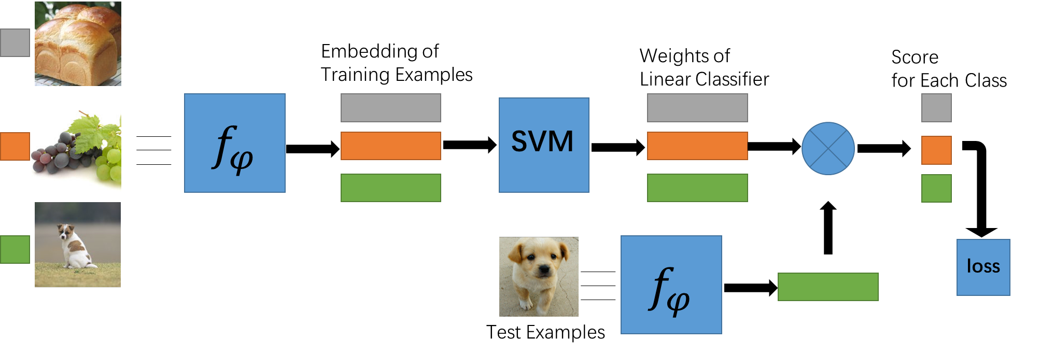
1.MAML
Fig. 1. MetaOptNet

Slide 6
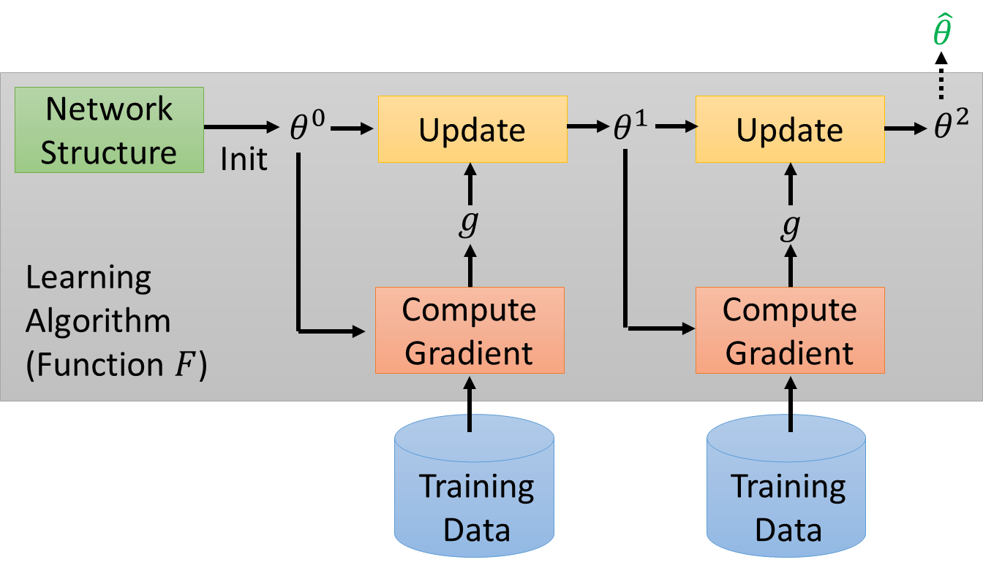
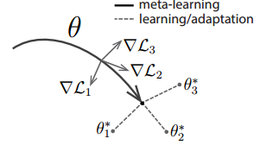

1.MAML
Find initialization parameter $θ$
Fig. 2. MAML
Notes:
作者希望通过改变梯度下降的方向（图2所示），找到对于任务分布来说敏感的参数，这些参数细微的改动能引起loss函数很大的变化。

Slide 7
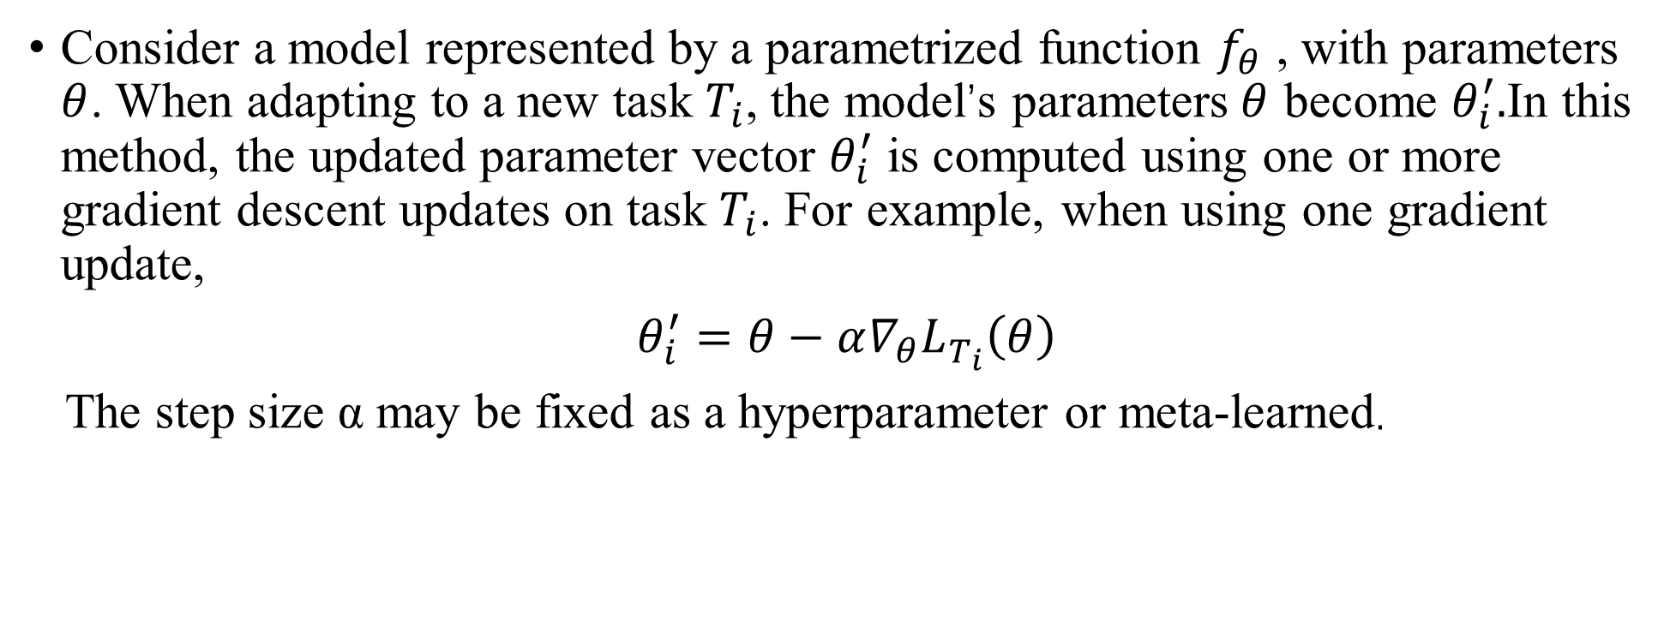
1.MAML
Consider a model represented by a parametrized function $f_{θ}$ , with parameters $θ$. When adapting to a new task $T_{i}$, the model’s parameters$θ$ become $θ_{i}^{′}.$In this method, the updated parameter vector $θ_{i}^{′}$ is computed using one or more gradient descent updates on task $T_{i}$. For example, when using one gradient update,
$θ_{i}^{′}=θ−α∇_{θ}L_{T_{i}}\left(θ\right)$
The step size α may be fixed as a hyperparameter or meta-learned.
Notes:
在形式上，我们考虑一个由参数[Math Processing Error]\thetaθ表示的参数化函数 fθ表示的模型。当学习新任务Ti时，模型参数从θ变成[Math Processing θ i′​ 。更新后的参数变量θ i′​是在任务Ti中经过一到多步梯度下降得到。比如一步梯度更新表示为:
步长α可以固定为超参数或元学习。为了表示简单，我们将在本节的其余部分考虑一步梯度更新，但是使用多步梯度更新是一个简单的扩展。
原文程序中进行了5次梯度下降，α=0.01

Slide 8
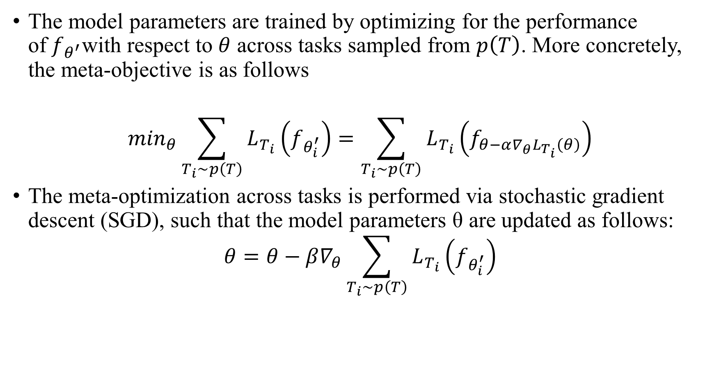
1.MAML
The model parameters are trained by optimizing for the performance of${ f}_{θ^{′}}$with respect to $θ$ across tasks sampled from $p\left(T\right)$. More concretely, the meta-objective is as follows
$$\min_{θ}\sum_{T_{i}\sim p\left(T\right)}{L_{T_{i}}}\left(f_{θ_{i}^{′}}\right)=\sum_{T_{i}\sim p\left(T\right)}{L_{T_{i}}}\left(f_{θ−α∇_{θ}L_{T_{i}}\left(θ\right)}\right)$$
The meta-optimization across tasks is performed via stochastic gradient descent (SGD), such that the model parameters θ are updated as follows:
$$θ=θ−β∇_{θ}\sum_{T_{i}\sim p\left(T\right)}{L_{T_{i}}}\left(f_{θ_{i}^{′}}\right)$$
Notes:
$β$=0.001，进行一次随机梯度下降。
并不在意是否在train task上损失最小，而是在乎通过$θ$训练出来的$θ_{i}^{′}$表现如何，更关心$θ$的潜力

Slide 9
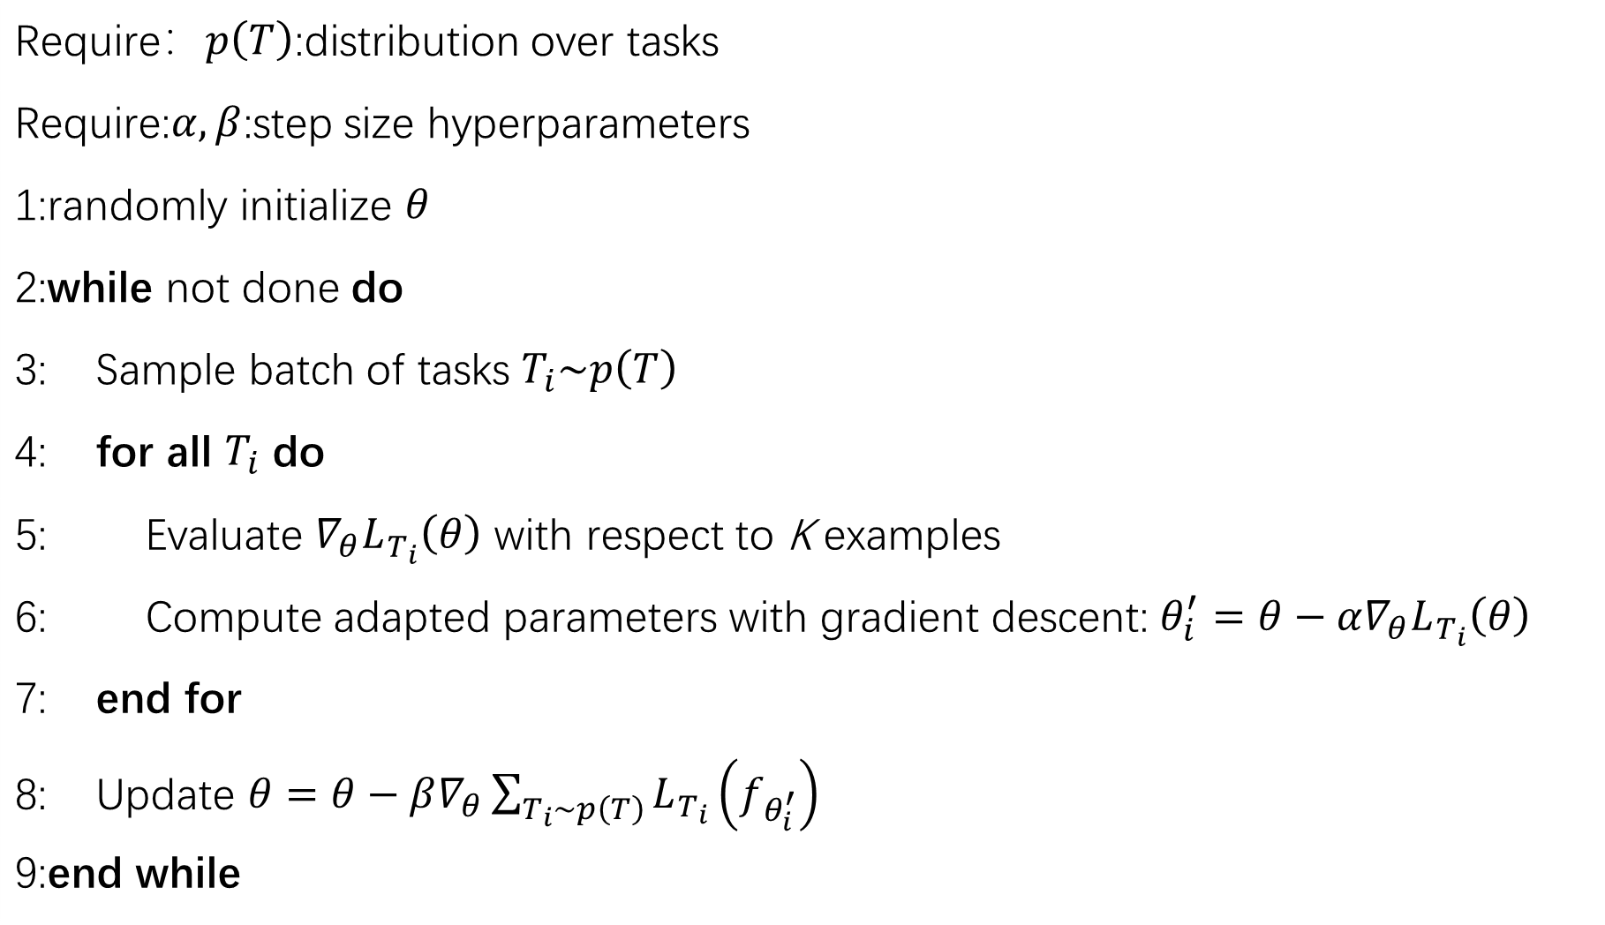
Require：$p\left(T\right)$:distribution over tasks
Require:$α,β$:step size hyperparameters
1:randomly initialize $θ$
2:while not done do
3: Sample batch of tasks $T_{i}\sim p\left(T\right)$
4: for all $T_{i}$ do
5: Evaluate $∇_{θ}L_{T_{i}}\left(θ\right)$ with respect to K examples
6: Compute adapted parameters with gradient descent: $θ_{i}^{′}=θ−α∇_{θ}L_{T_{i}}\left(θ\right)$
7: end for
8: Update $θ=θ−β∇_{θ}\sum_{T_{i}\sim p\left(T\right)}{L_{T_{i}}}\left(f_{θ_{i}^{′}}\right)$
9:end while
Notes:
步骤5,对利用batch中的某一个task中的support set，计算每个参数的梯度。
步骤8,对应第二次梯度更新的过程。loss计算方法，大致与步骤5相同，但是不同点有两处。1.不再是分别利用每个task的loss更新梯度，而是像常见的模型训练过程一样，计算一个batch的loss总和，对梯度进行随机梯度下降SGD。2.这里参与计算的样本，是task中的query set
程序中体现，论文中未体现。

Slide 10
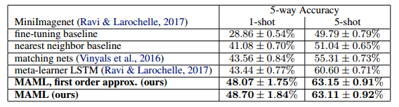
1.MAML

Slide 11
2.LEO
Gradient-based meta-learning techniques have practical difficulties when operating on high-dimensional parameter spaces in extreme low-data regimes.
It is possible to bypass these limitations by learning a data-dependent latent generative representation of model parameters, and performing gradient-based meta-learning in this low-dimensional latent space.
Latent embedding optimization (LEO), decouples the gradient-based adaptation procedure from the underlying high-dimensional space of model parameters.
Notes:
基于梯度的元学习技术当在极低数据体系中的高维参数空间上操作时，它们具有实际困难。
通过学习模型参数的数据依赖潜在生成表示，并在这个低维潜在空间中执行基于梯度的元学习，可以绕过这些限制。
潜在嵌入优化（LEO），将基于梯度的自适应过程与模型参数的基础高维空间分离。

Slide 12
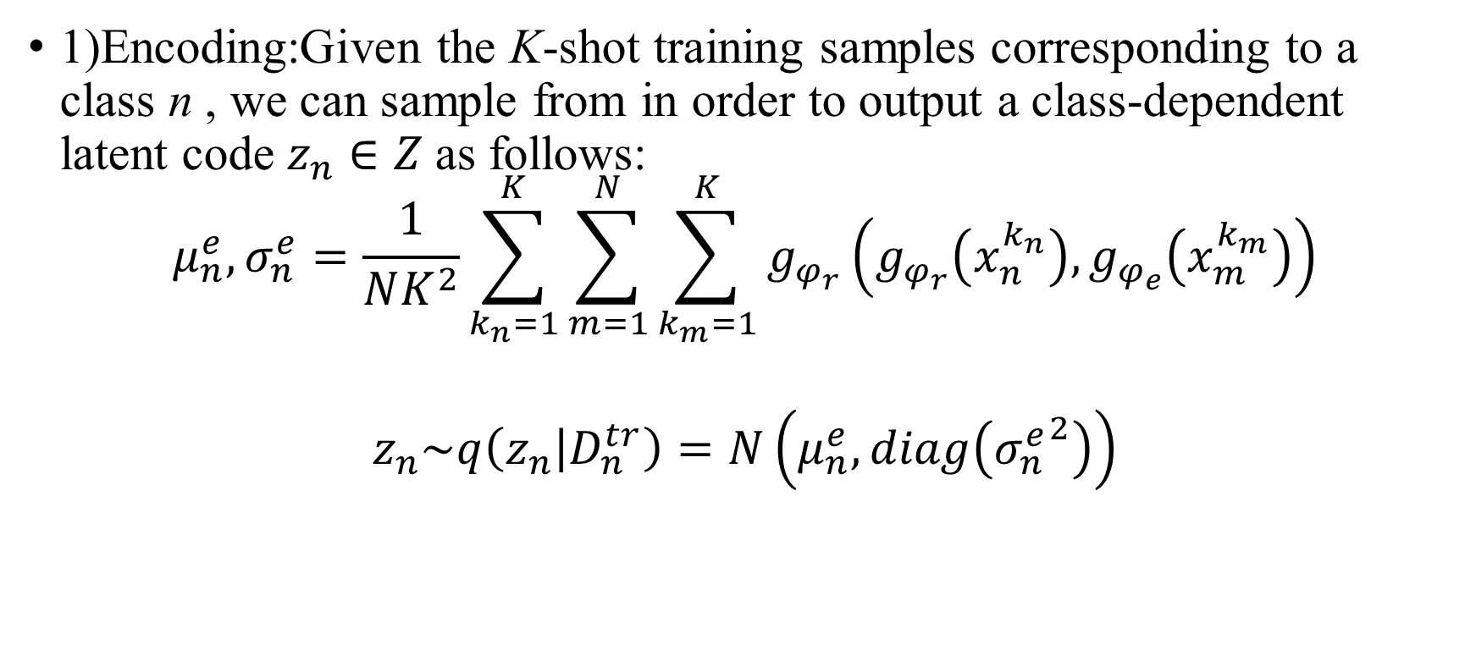
2.LEO
1)Encoding:Given the K-shot training samples corresponding to a class n , we can sample from in order to output a class-dependent latent code $z_{n}∈Z$as follows:
$$μ_{n}^{e},σ_{n}^{e}=\frac{1}{NK^{2}}\sum_{k_{n}=1}^{K}{\sum_{m=1}^{N}{\sum_{k_{m}=1}^{K}{g_{φ_{r}}\left(g_{φ_{r}}\left(x_{n}^{k_{n}}\right),g_{φ_{e}}\left(x_{m}^{k_{m}}\right)\right)}}}$$
$$z_{n}\sim q\left(z_{n} | D_{n}^{tr}\right)=N\left(μ_{n}^{e},diag\left({σ_{n}^{e}}^{2}\right)\right)$$

Slide 13
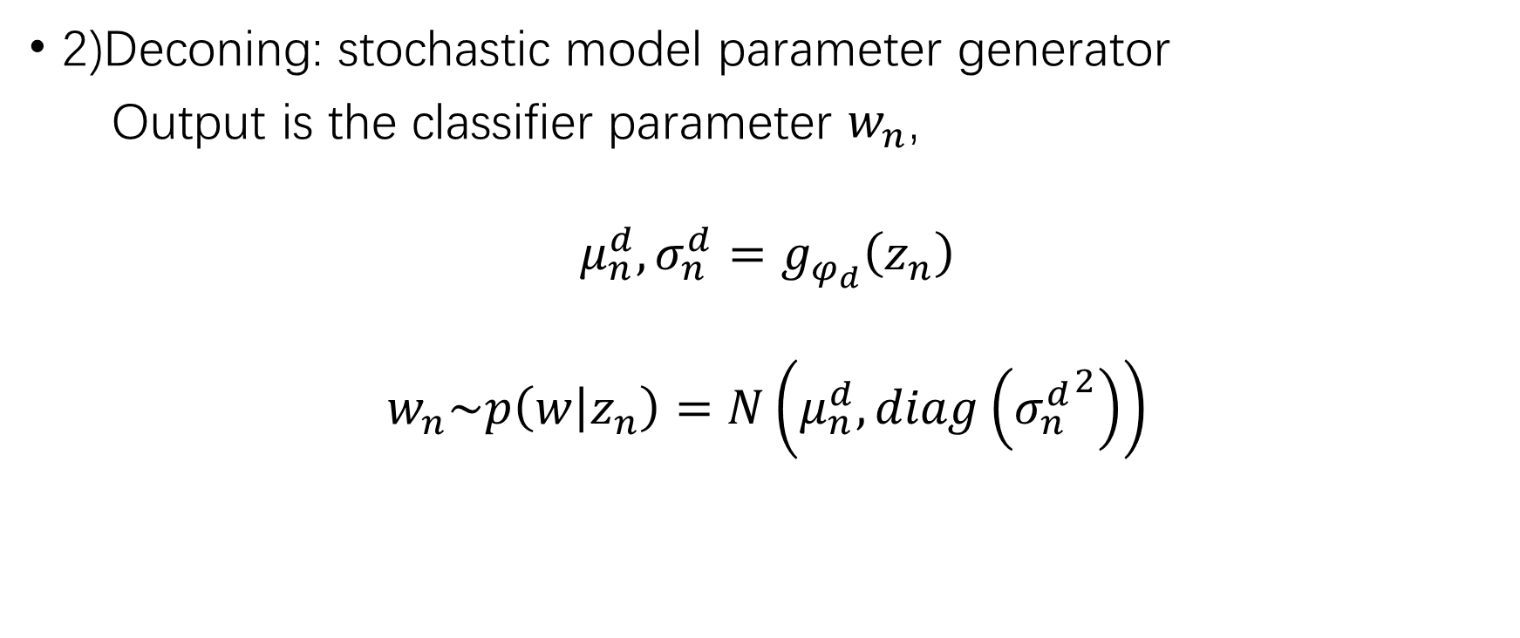
2.LEO
2)Deconing: stochastic model parameter generator
Output is the classifier parameter $w_{n}$,
$$μ_{n}^{d},σ_{n}^{d}=g_{φ_{d}}\left(z_{n}\right)$$
$$w_{n}\sim p\left(w | z_{n}\right)=N\left(μ_{n}^{d},diag\left({σ_{n}^{d}}^{2}\right)\right)$$
Notes:
解码器：随机模型参数生成
输出类别参数wn

Slide 14
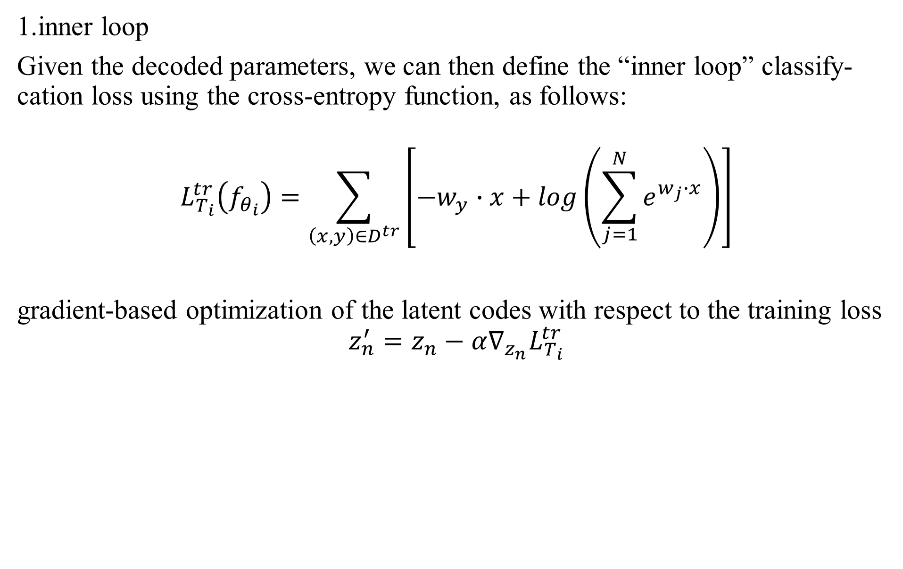
2.LEO
1.inner loop
Given the decoded parameters, we can then define the “inner loop” classify-cation loss using the cross-entropy function, as follows:
$$L_{T_{i}}^{tr}\left(f_{θ_{i}}\right)=\sum_{\left(x,y\right)∈D^{tr}}{\left[−w_{y}∙x+log\left(\sum_{j=1}^{N}{e^{w_{j}∙x}}\right)\right]}$$
gradient-based optimization of the latent codes with respect to the training loss
$$z_{n}^{′}=z_{n}−α∇_{z_{n}}L_{T_{i}}^{tr}$$
Notes:
给定解码后的参数，我们可以使用交叉熵函数定义“内环”分类损失，如下所示：
重要的是要注意，解码器gφ在潜空间Z和高维模型参数空间Θ之间存在微分映射。 首先，这允许关于训练损失的潜码基于梯度的优化，
解码器gφd会将适应的潜在代码z'n转换为每个适应步骤的有效模型参数θ'i，可以重复多次，如算法1所示。此外，通过解码器反向传播错误，编码器和关系网可以学习提供数据条件的潜在 编码z会为分类器模型生成适当的初始化点θi。

Slide 15
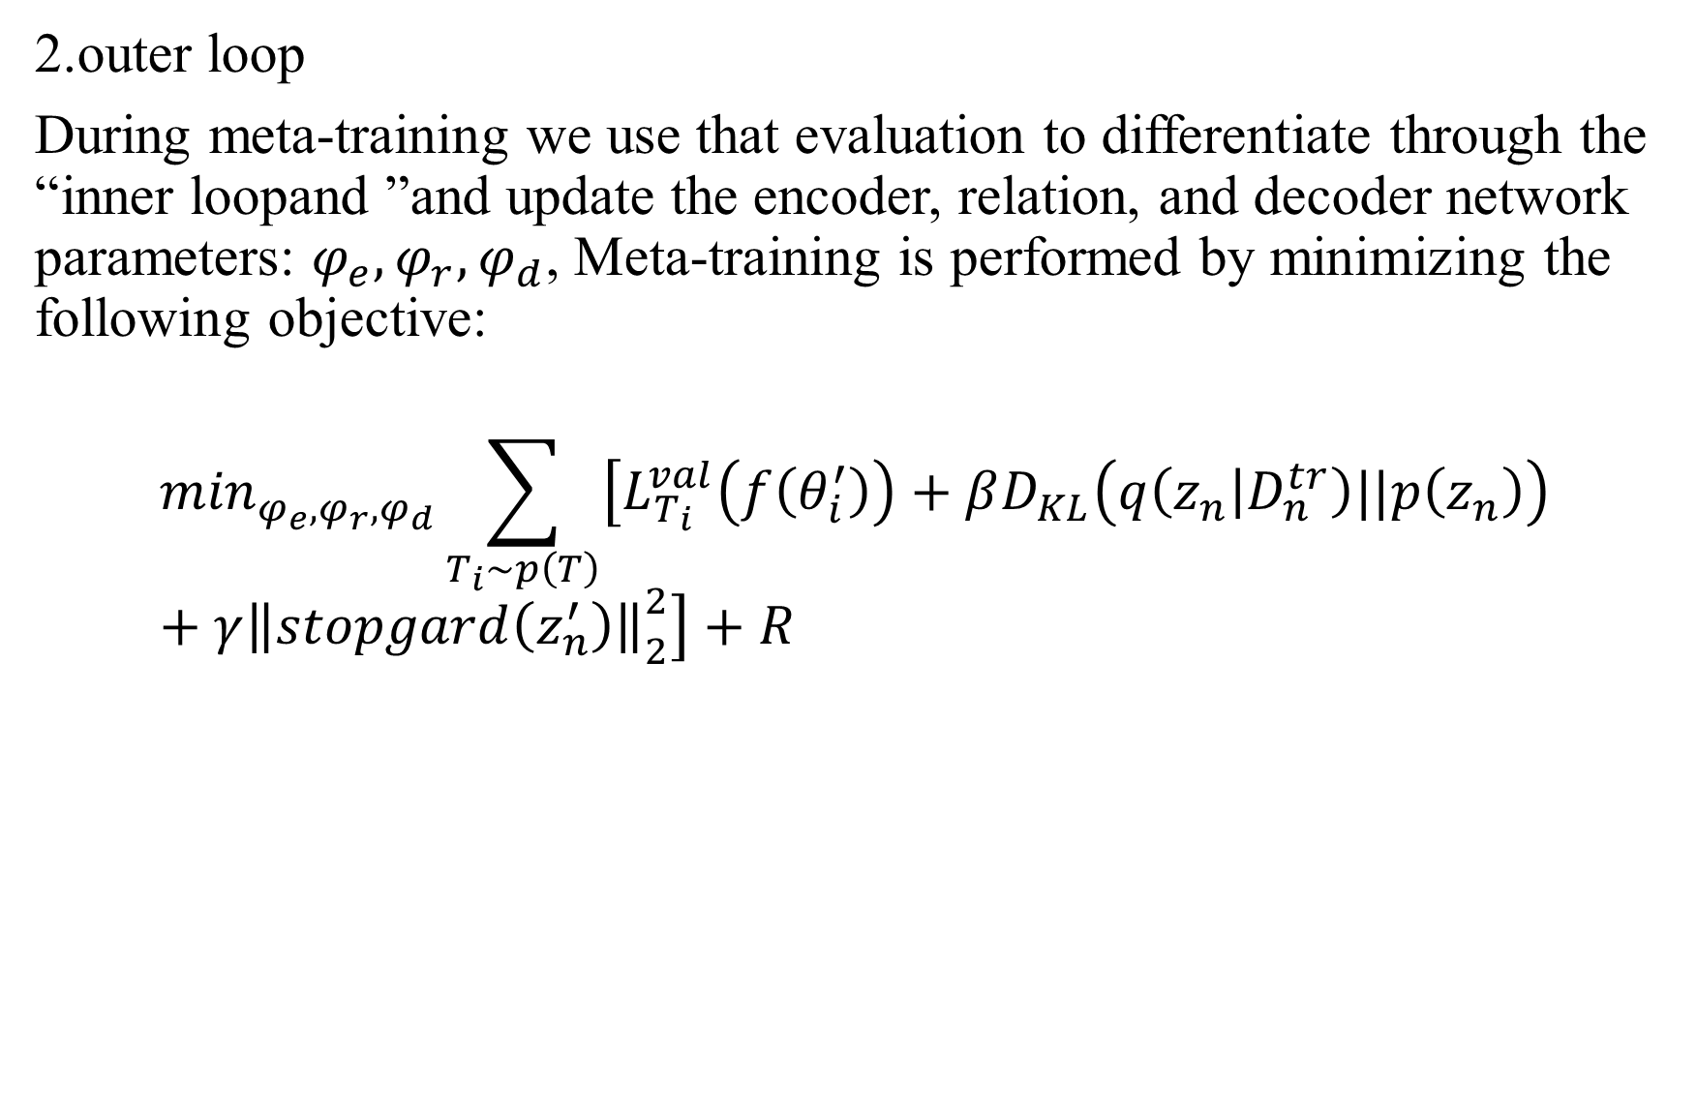
2.LEO
2.outer loop
During meta-training we use that evaluation to differentiate through the “inner loopand ”and update the encoder, relation, and decoder network parameters: $φ_{e},φ_{r},φ_{d}$, Meta-training is performed by minimizing the following objective:
$$\min_{φ_{e},φ_{r},φ_{d}}\sum_{T_{i}\sim p\left(T\right)}{\left[L_{T_{i}}^{val}\left(f\left(θ_{i}^{′}\right)\right)+βD_{KL}\left(q\left(z_{n} | D_{n}^{tr}\right)||p\left(z_{n}\right)\right)+γ{\left\|\left.stopgard\left(z_{n}^{′}\right)\right\|\right.}_{2}^{2}\right]}+R$$
Notes:
在元训练期间，我们使用该评估通过“内环”进行区分，并更新编码器，关系和解码器网络参数：φe，φr和φd。 通过最小化以下目标来执行元训练：
其中p（zn）= N（0，I）。 与（Higgins et al。，2017）中定义的损失相似，我们使用加权KL散度项来规范化潜在空间并鼓励生成模型学习非纠缠的嵌入，这也应该通过消除潜在空间梯度维度之间的相关性来简化LEO“内环”。
第三项鼓励编码器和关系网输出接近适配代码的参数初始化，从而在可能的情况下减少适配过程的负担

Slide 16
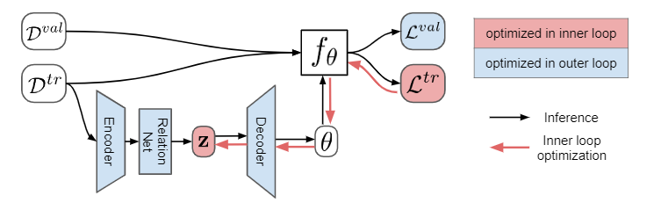
2.LEO
Fig. 3. LEO

Slide 17
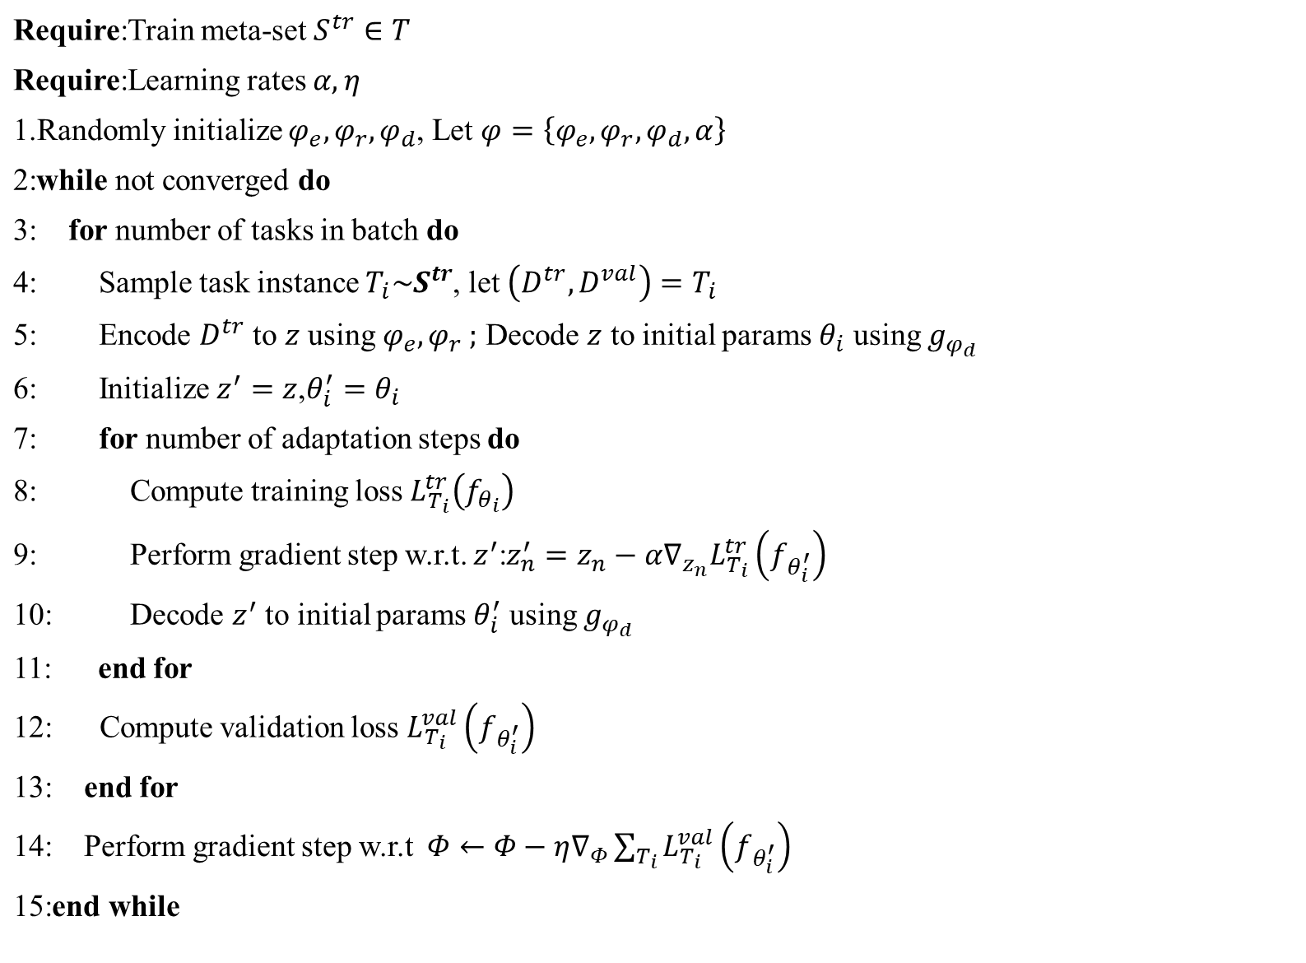
Require:Train meta-set $S^{tr}∈T$
Require:Learning rates $α,η$
1.Randomly initialize $φ_{e},φ_{r},φ_{d}$, Let $φ=\left\{φ_{e},φ_{r},φ_{d},α\right\}$
2:while not converged do
3: for number of tasks in batch do
4: Sample task instance $T_{i}\sim S^{tr}$, let $\left(D^{tr},D^{val}\right)=T_{i}$
5: Encode $D^{tr}$ to $z$ using $φ_{e},φ_{r} ;$ Decode $z$ to initial params $θ_{i}$ using${ g}_{φ_{d}}$
6: Initialize $z^{′}=z$,$θ_{i}^{′}=θ_{i}$
7: for number of adaptation steps do
8: Compute training loss $L_{T_{i}}^{tr}\left(f_{θ_{i}}\right)$
9: Perform gradient step w.r.t. $z^{′}$:$z_{n}^{′}=z_{n}−α∇_{z_{n}}L_{T_{i}}^{tr}\left(f_{θ_{i}^{′}}\right)$
10: Decode $z^{′}$ to initial params $θ_{i}^{′}$ using $g_{φ_{d}}$
11: end for
12: Compute validation loss $L_{T_{i}}^{val}\left(f_{θ_{i}^{′}}\right)$
13: end for
14: Perform gradient step w.r.t $Φ←Φ−η∇_{Φ}\sum_{T_{i}}{L_{T_{i}}^{val}\left(f_{θ_{i}^{′}}\right)}$
15:end while
Notes:
w.r.t. ： with respect to 的缩写。关于；谈及，谈到

Slide 18
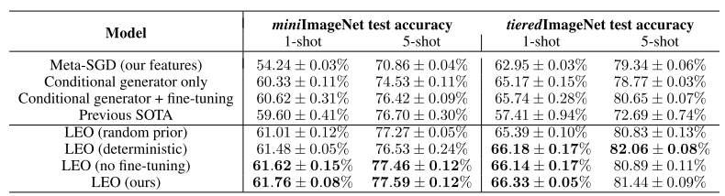
2.LEO

